Slide 1
Calculating Family Expenses Using Service Now
NAAN MUDHALVAN PROJECT
TEAM ID : NM2025TMID13320

Slide 2
TEAM ID : NM2025TMID13320 Team Size : 4 Team Leader : ARUN . S Team member : AKSHAY. A Team member : ARUNKUMAR. D Team member : BASKAR . P

Slide 3
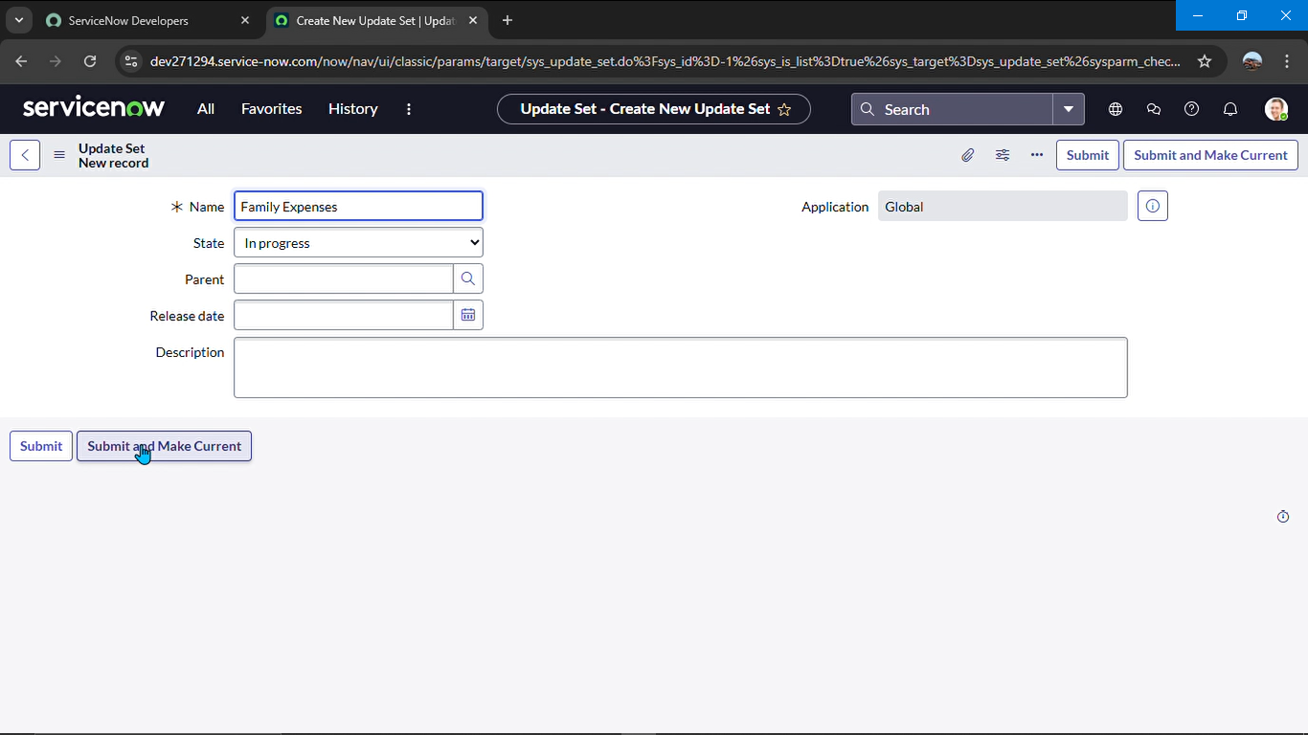
Creation Of New Update Set
1 . Go to all > filter search for Local Update set .
2 . Click new
3 . Enter detail name : Family Expenses
4 . Submit and make current

Slide 4
Creation Of Table
Creation of new update set
1.Go to all > search for Local update set
2. Click new
3. Deatil = name - family expenses
4.Submit and make current

Slide 5
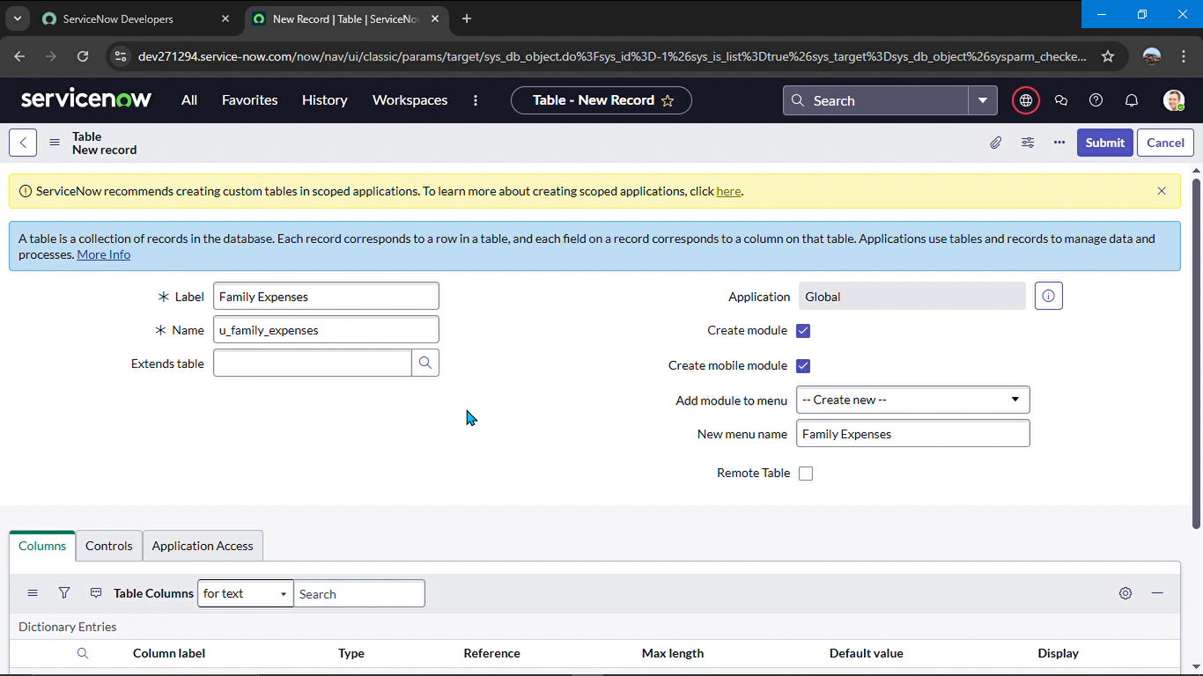
Creation Table
Creation of family expense table
1. Go to All > In the filter search for Tables > click on New.
Enter the Details:
Label : Family Expenses
Name : Auto-Populated
New menu name : Family Expenditure
2. Go header right click there > click save

Slide 6
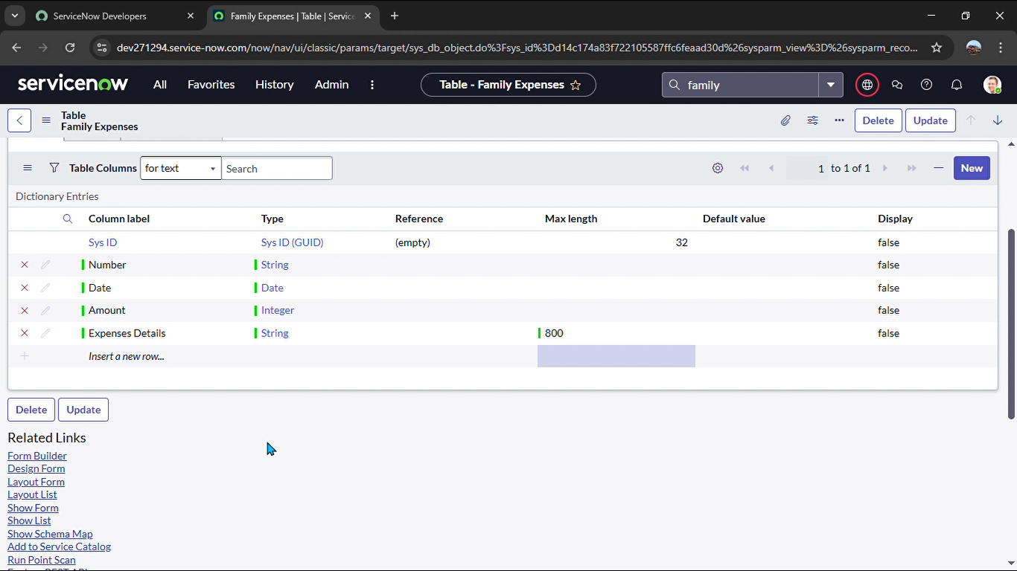
Creation of Columns(Fields)
Column label : Number
Type : String
Double click on insert a new row again
Give the details as:
Column label : Date
Type : Date
Double click on insert a new row again
Give the details as:
Column label : Amount
Type : Integer
Double click on insert a new row again
Give the details as:
Column label : Expense Details
Type : String
Max length : 800

Slide 7
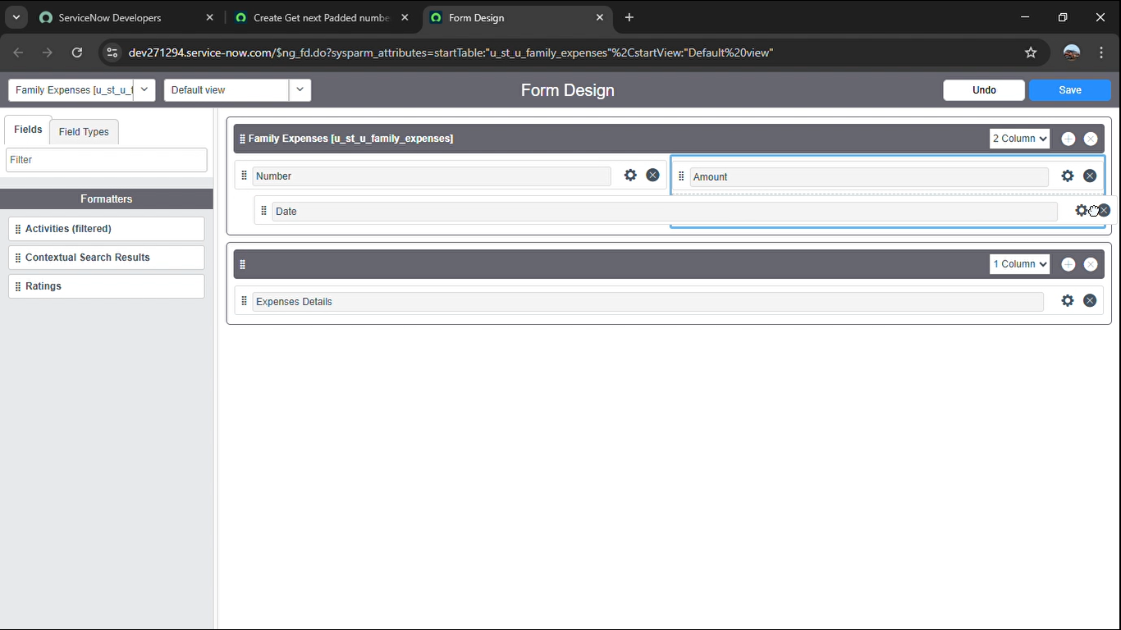
Configure the Form
Go all > search family expenses
Click new
Header configure select form design
Make date , amount, mandatory
Click save

Slide 8
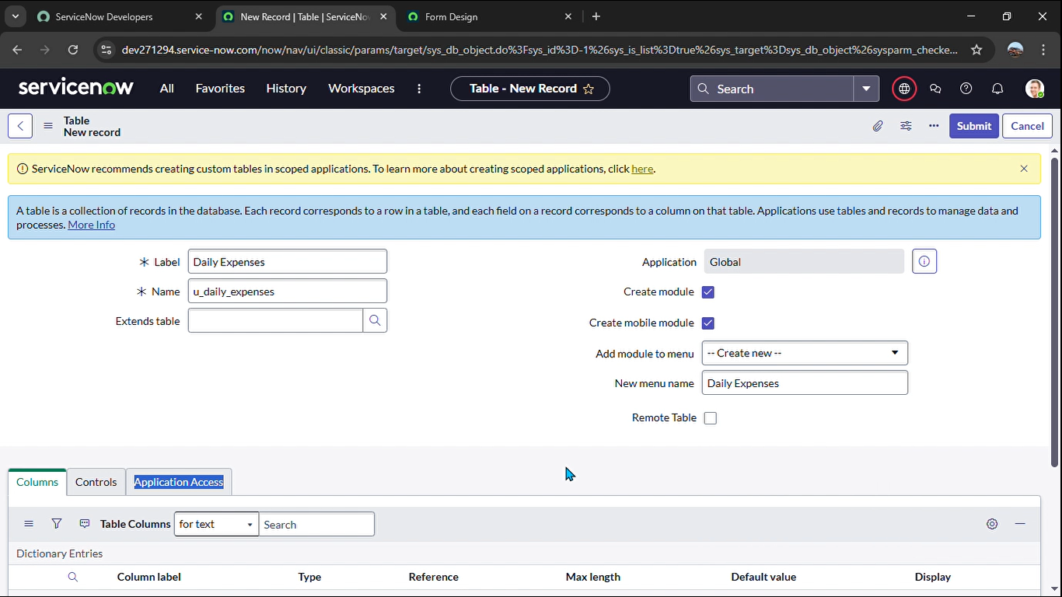
Creation of Daily Expenses Table
Go all > search tables
Details : daily expenses
Name : auto populated
Click right there and save

Slide 9
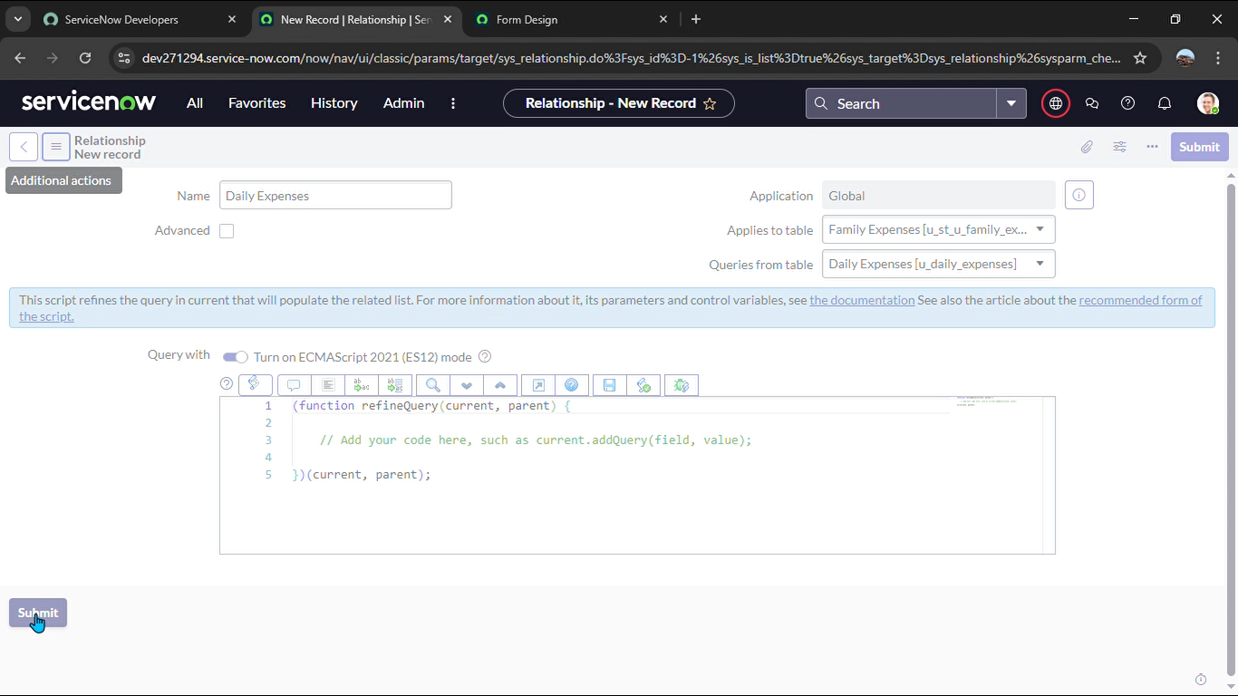
Creation of Business Rules
Go all > search Business rules
Detail name : family expenses BR
Table : daily expenses
When to run check insert and update
Then type code
Go to header and right click there >> click on save

Slide 10
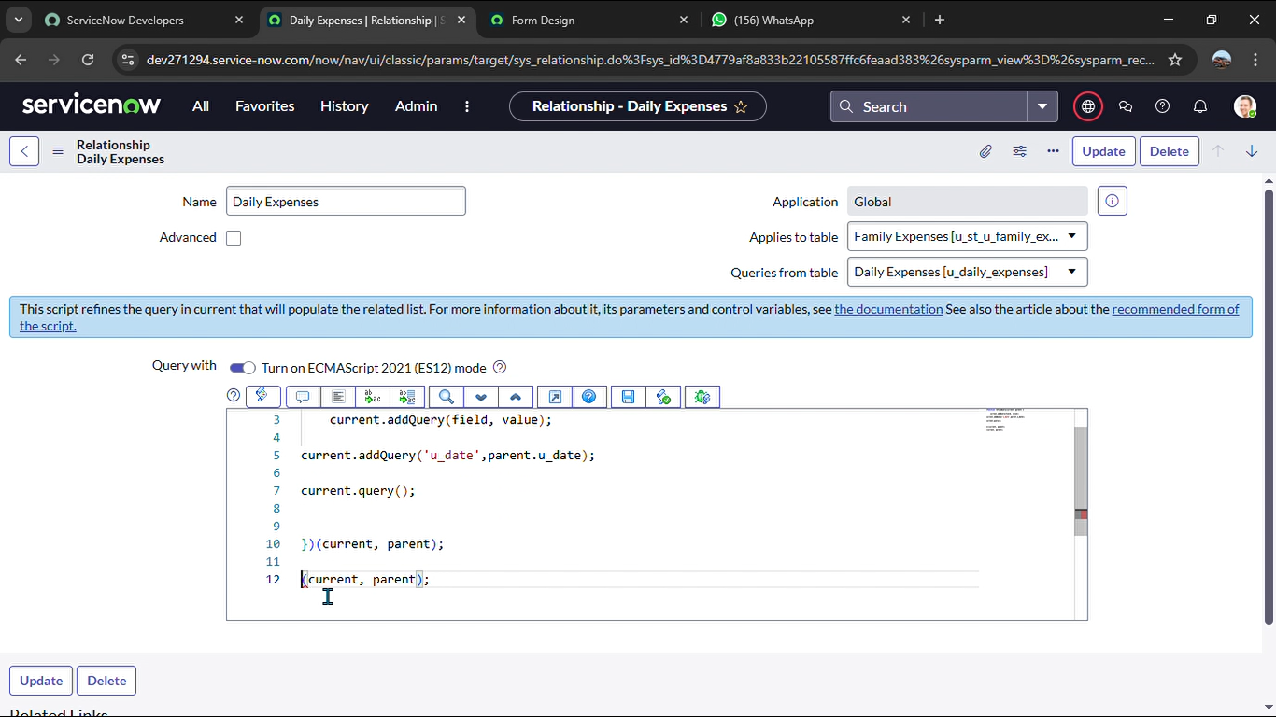
Configure the Relationship
Go all >> search relationship
Oopen daily expenses
Applies select family expenses
Then type a code
Click on update

Slide 11
Conclution
Calculating Family Expenses Using Service Now
This Project Has Done By
TEAM LEADER : ARUN.S
TEAM MEMBER 1: AKSHYA.A
TEAM MEMBER 2: ARUNKUMAR.D
TEAM MEMBER 3: BASKAR.P
Using ServiceNow to track family expenses streamlines budgeting through automation and clear reporting. It helps families monitor spending, improve financial planning, and make informed decisions more efficiently.

